Slide 1
UNIT III: Probability distributions

Slide 2
UNIT III: Probability distributions
Distribution Function, Probability Mass Function, Probability density function, Continuous Distributions: Normal Distribution, joint probability distribution, Discrete Distributions: Binomial distribution, Poisson's distribution-Illustrative examples

Slide 3
Introduction
In Statistics, the probability distribution gives the possibility of each outcome of a random experiment or event. It provides the probabilities of different possible occurrences.
To recall, the probability is a measure of uncertainty of various phenomena. Like, if you throw a dice, the possible outcomes of it, is defined by the probability. This distribution could be defined with any random experiments, whose outcome is not sure or could not be predicted. Let us discuss now its definition, function, formula and its types here, along with how to create a table of probability based on random variables.

Slide 4
Definition
A probability distribution is a mathematical function that describes the probability of different possible values of a variable.
Probability distribution yields the possible outcomes for any random event.
It is also defined based on the underlying sample space as a set of possible outcomes of any random experiment.
These settings could be a set of real numbers or a set of vectors or a set of any entities. It is a part of probability and statistics.
Probability distributions are often depicted using graphs or probability tables

Slide 5
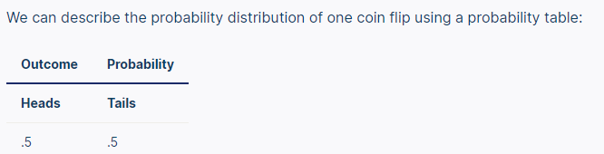
Example: Probability distribution

Slide 6
What is a probability distribution?
A probability distribution is an idealized frequency distribution.
A frequency distribution describes a specific sample or dataset. It’s the number of times each possible value of a variable occurs in the dataset.
The number of times a value occurs in a sample is determined by its probability of occurrence. Probability is a number between 0 and 1 that says how likely something is to occur: 0 means it’s impossible. 1 means it’s certain.
The higher the probability of a value, the higher its frequency in a sample.
More specifically, the probability of a value is its relative frequency in an infinitely large sample.
Infinitely large samples are impossible in real life, so probability distributions are theoretical. They’re idealized versions of frequency distributions that aim to describe the population the sample was drawn from.
Probability distributions are used to describe the populations of real-life variables, like coin tosses or the weight of chicken eggs. They’re also used in hypothesis testing to determine p values.

Slide 7
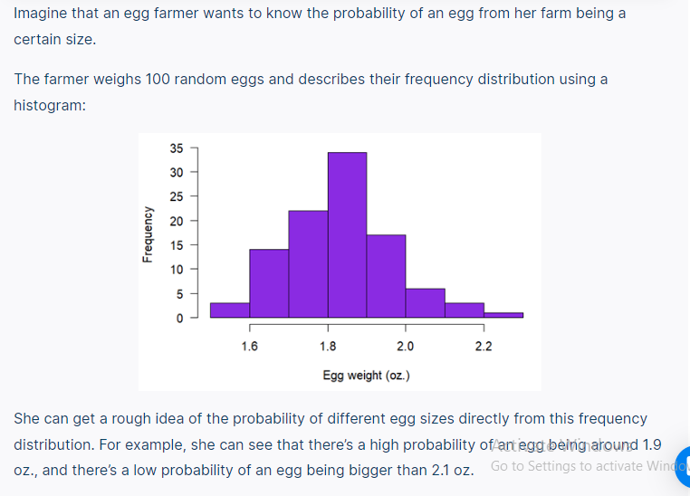
Example: Probability distributions are idealized frequency distributions

Slide 8
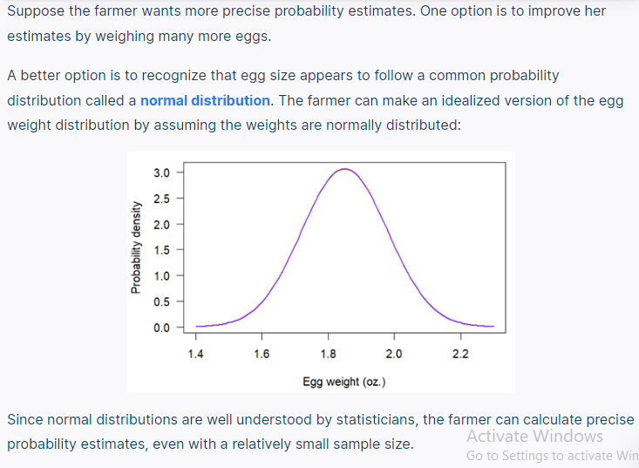
Example: Probability distributions are idealized frequency distributions

Slide 9

Variables that follow a probability distribution are called random variables. There’s special notation you can use to say that a random variable follows a specific distribution:
Random variables are usually denoted by X.
The ~ (tilde) symbol means “follows the distribution.”
The distribution is denoted by a capital letter (usually the first letter of the distribution’s name), followed by brackets that contain the distribution’s parameters.
For example, the following notation means “the random variable X follows a normal distribution with a mean of µ and a variance of σ².”

Slide 10
Probability Distribution Function
A function which is used to define the distribution of a probability is called a Probability distribution function. Depending upon the types, we can define these functions. Also, these functions are used in terms of probability density functions for any given random variable.
In the case of Normal distribution, the function of a real-valued random variable X is the function given by;
F_{X}(x) = P(X ≤ x)
Where P shows the probability that the random variable X occurs on less than or equal to the value of x.

Slide 11
Probability mass functions
A probability mass function (PMF) is a mathematical function that describes a discrete probability distribution. It gives the probability of every possible value of a variable.
A probability mass function can be represented as an equation or as a graph

Slide 12
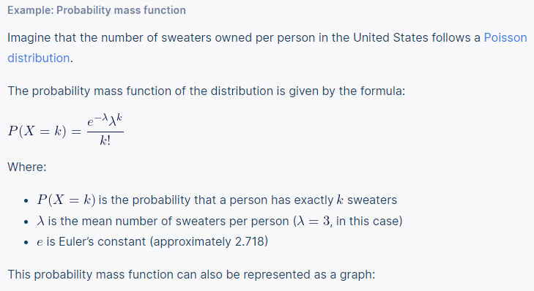

Slide 13
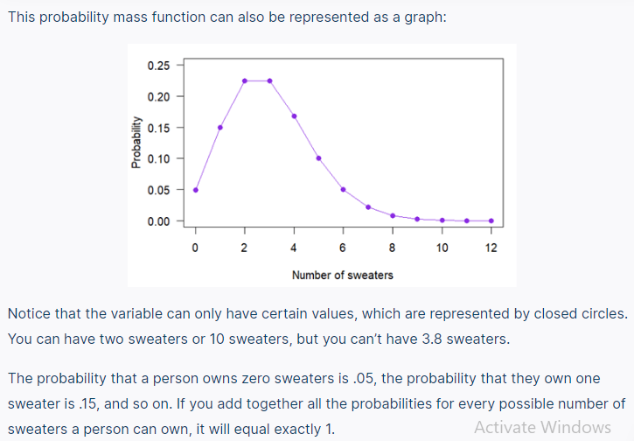

Slide 14
Probability density functions
A probability density function (PDF) is a mathematical function that describes a continuous probability distribution. It provides the probability density of each value of a variable, which can be greater than one.
A probability density function can be represented as an equation or as a graph.
In graph form, a probability density function is a curve. You can determine the probability that a value will fall within a certain interval by calculating the area under the curve within that interval. You can use reference tables or software to calculate the area.
The area under the whole curve is always exactly one because it’s certain (i.e., a probability of one) that an observation will fall somewhere in the variable’s range.
A cumulative distribution function is another type of function that describes a continuous probability distribution.

Slide 15
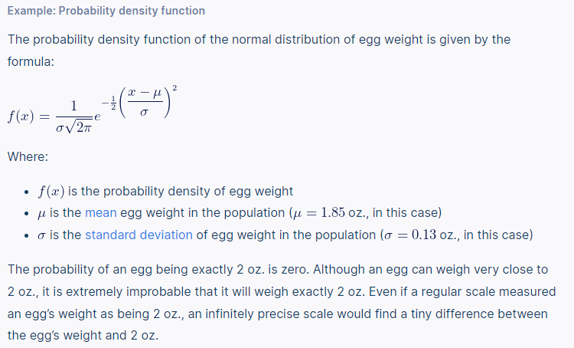

Slide 16
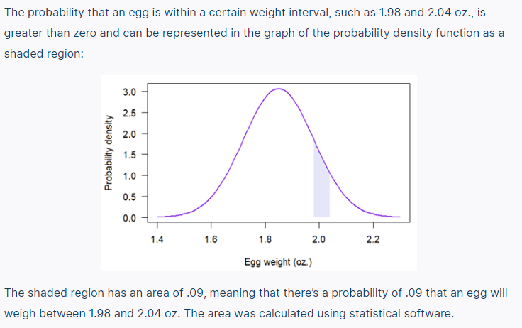

Slide 17
Probability tables
A probability table represents the discrete probability distribution of a categorical variable. Probability tables can also represent a discrete variable with only a few possible values or a continuous variable that’s been grouped into class intervals.
A probability table is composed of two columns:
The values or class intervals
Their probabilities

Slide 18
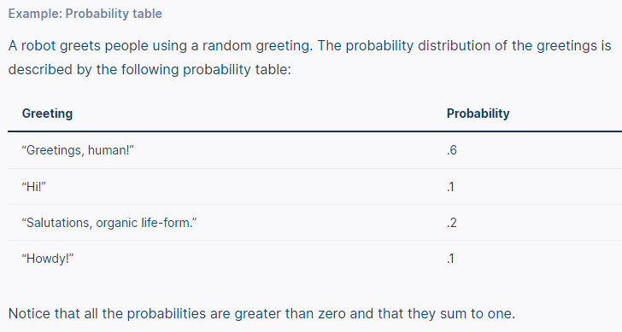

Slide 19
Types of Probability Distribution
There are two types of probability distribution which are used for different purposes and various types of the data generation process.
Continuous Probability Distribution
Discrete Probability Distribution

